Slide 1
COAL Lab (EL-213)
Fall 2017

Slide 2
Data Representation
Representing the contents of memory
Each numbering format, or system, has a base, or maximum number of symbols that can be assigned to a single digit
This base is also called . . .

Slide 3

Binary Numbers
The MSB and LSB bit numbers of a 16-bit binary number are shown as:

Slide 4
Unsigned Binary to Decimal

Slide 5
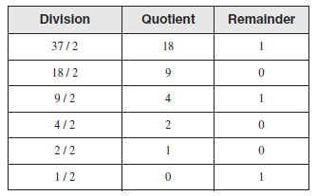
Unsigned Decimal to Binary
To convert from unsigned decimal to binary, repeated division method is usually used

Slide 6
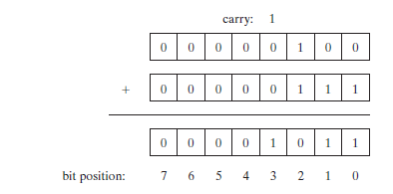
Binary Addition

Slide 7
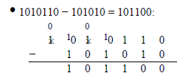
Binary Subtraction

Slide 8

Unsigned Binary to Decimal (contd.)

Slide 9
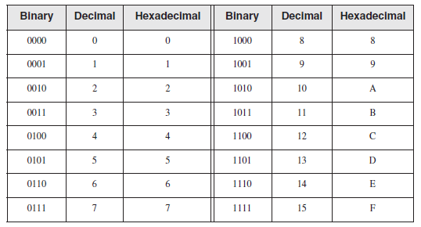
Hexadecimal Numbers
Hexadecimal digits offer a convenient way to represent binary data

Slide 10

Unsigned Hexadecimal to Decimal

Slide 11
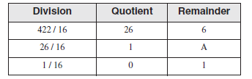
Unsigned Decimal to Hexadecimal

Slide 12
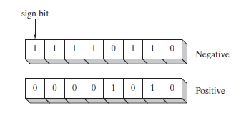
Signed Integers

Slide 13
Two’s Complement of Binary
Negative integers can be represented as Two’s Complement
It is useful because it eliminates the need for separate digital circuits
Example: A – B can be represented as A + (-B)

Slide 14

Two’s Complement of Hexadecimal
To create two’s complement of Hexadecimal integer: reverse all bits and add 1
To reverse a bit in Hexadecimal integers, subtract the digit from 15
Example:

Slide 15
Signed Binary to Decimal
If the highest bit is 0, the conversion is trivial
If the highest bit is 1, take two’s complement of the binary integer and perform conversion
Write a (-) sign with the converted decimal number to indicate negative integer

Slide 16
Signed Decimal to Binary
Convert absolute decimal number to Binary as before
Take two’s complement of converted binary integer

Slide 17
Signed Hexadecimal to Decimal
If hexadecimal integer is negative, take it’s two’s complement and convert it to Decimal
Write a (-) sign with converted decimal
Note: A hexadecimal number is –ve if . . .

Slide 18
Signed Decimal to Hexadecimal
Convert absolute value of decimal to hexadecimal
Take two’s complement of the converted hexadecimal integer

Slide 19
Character Storage
ASCII
ANSI
Unicode (UTF-8, UTF-16 & UTF-32)

Slide 20

Boolean Operations

